Slide 1

Data Analytics in Real-Life: Building a Health Care Management System
A Practical Approach to Leveraging Data Analytics in the Medical Sector
Name : Mohak Shah (Data Scientist)
Team :
Nilax Modi – UI/UX Designer
Kishan Meghani – Backend Developer
Uday Panchal – Project Lead (Bk Dev)

Slide 2
Description
What is Data Analytics?
Data Analytics involves collecting, processing, analyzing, and sharing data to make informed decisions.
Objective of the Project:
To develop a Health Care Management System that leverages Data Analytics for personalized patient care and efficient health service delivery.
Features:
  Appointment scheduling
  Patient management
  Telemedicine
  Preventive care alerts
  Mental health chatbot

Slide 3
Plan
Goal:
  The primary goal is to design a Health Care Management System that integrates Data Analytics to provide personalized and efficient care for patients.
  Understand and meet the needs of key stakeholders.
Key Questions:
  What Features Are Essential for Each User?
    Patients: Appointment scheduling, health recommendations, access to telemedicine services, reminders for check-ups/vaccinations.
    Doctors/Medical Staff: Patient data management, telemedicine integration, monitoring patient progress, providing preventive care alerts.
    Admin: Manage patient records, system updates, and ensure offline functionalities for patients in remote areas.
  What Data Is Needed to Support These Features?
    Patient Data: Demographics, medical history, symptoms, past appointments.
    Health Data: Symptom-disease mapping, disease trends, vaccination records.
    Interaction Data: User interactions with the system (e.g., appointment requests, symptom input).
  How Will the System Operate Offline?
    Offline Functionality: Ensure the web app provides a downloadable version (100 MB size) that users can access even without an internet connection.
    Data Sync: Patients can use the system offline, with data syncing when the device is connected to the internet.

Slide 4
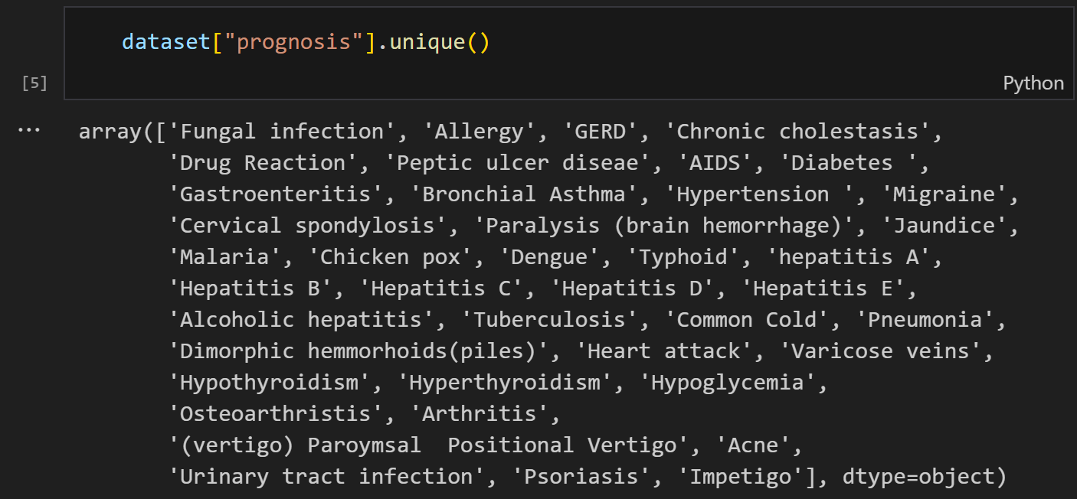
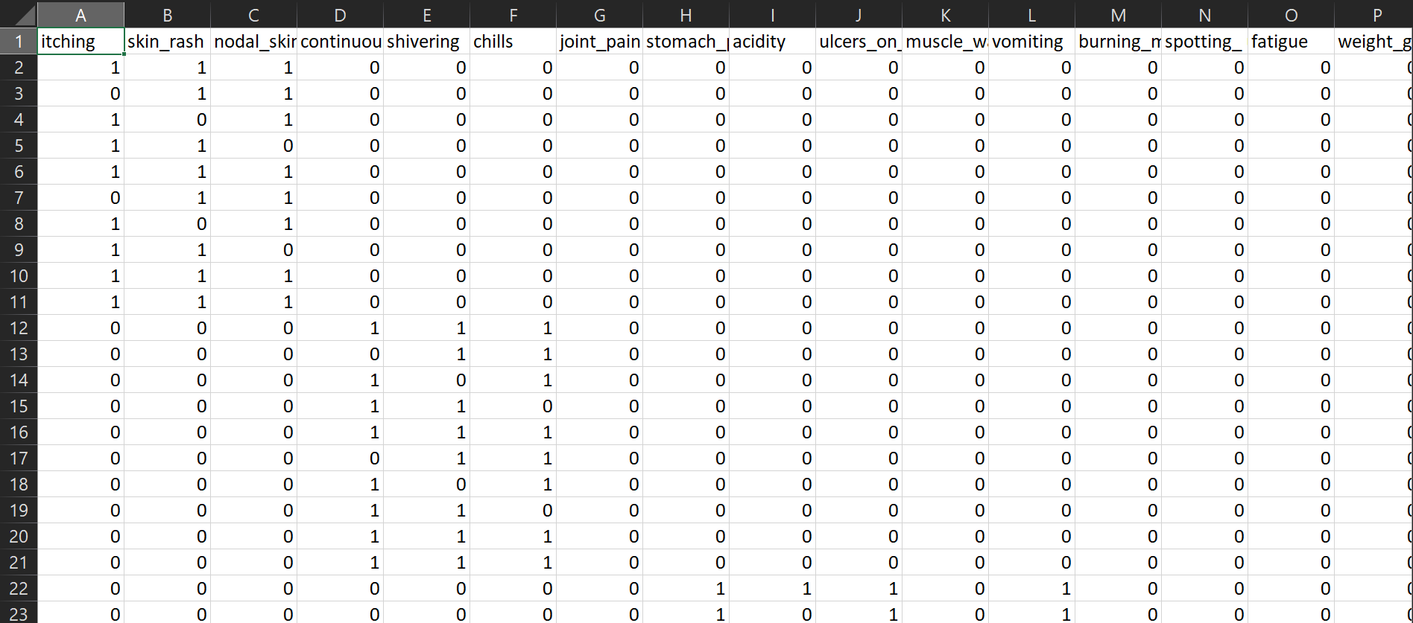

Prepare
Data Sources:
  Dataset of 132 symptoms and target diseases.
  Patient demographics and medical history.
  Appointment and telemedicine data trends.
Tools and Platforms:
  Programming Tools: Python, Flask
  Development Tools: PyCharm
  Deployment Platform: Render
  Product: Health Care Center

Slide 5
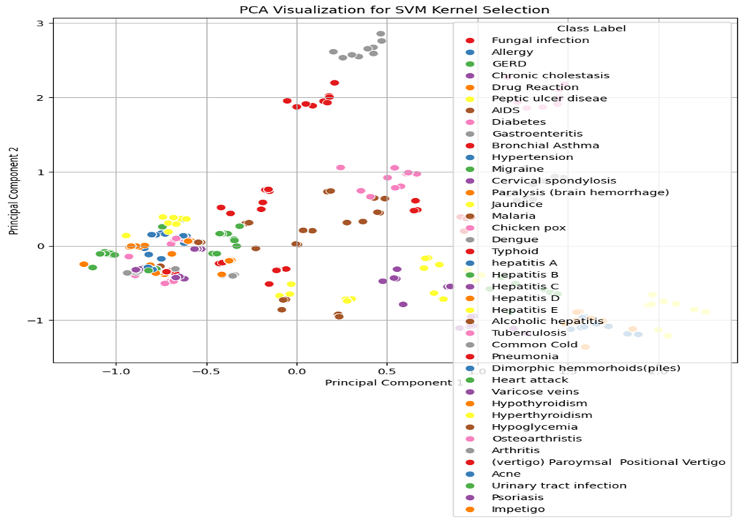
Process
Data Cleaning: Ensured consistency in symptom entries and patient records.
Model Training: Built a personalized recommendation system using the symptom-disease dataset.
API Integration: Created APIs for the ML model stored in a “.pkl” file to integrate with the web app.

Slide 6
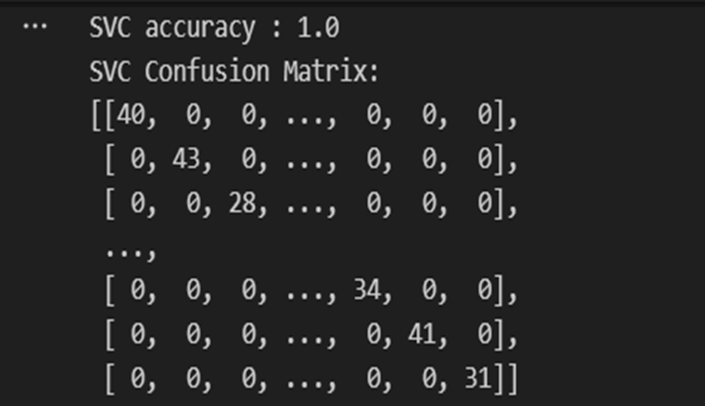
Analyse
Insights Derived:
  Identified frequently reported symptoms like fever, headache, fatigue, etc.
  Evaluated the model's accuracy and confusion matrix of SVC.

Slide 7
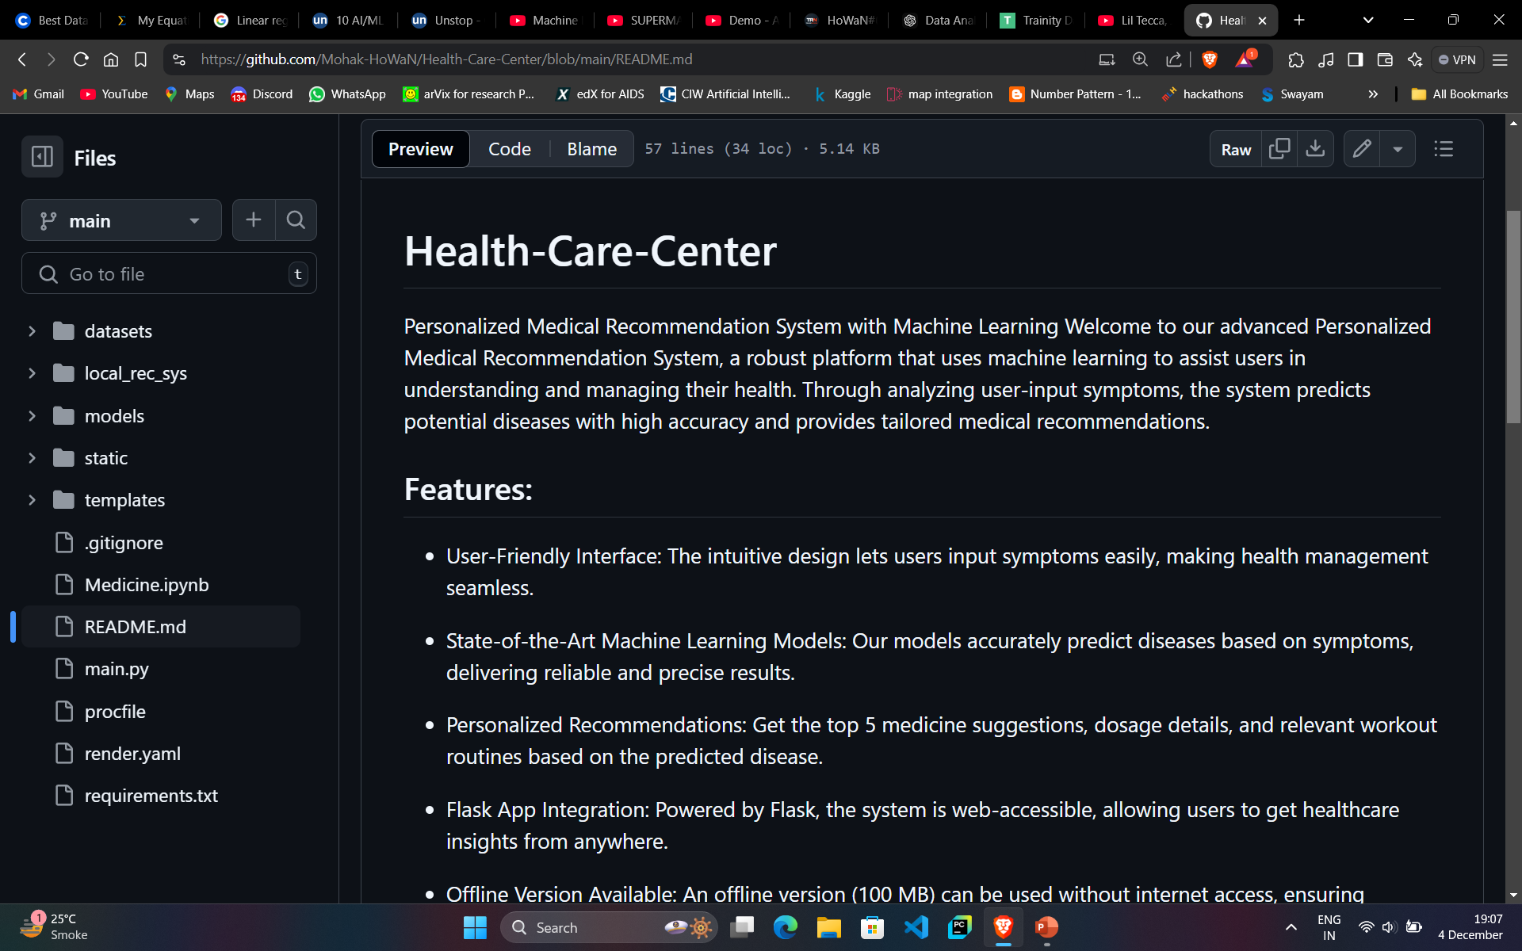

Share
Collaboration:
  Discussed requirements with the development team for feature alignment.
  Shared insights on improving user experience with feedback.
Documentation:
Developed a comprehensive README, including installation instructions and usage guidelines for the system.

Slide 8
ACT
Deployment:
  Successfully deployed the Health Care Management System using Flask on Render, ensuring reliability and scalability.
  Made an offline version (100 MB) available for download directly from the web app, allowing users to access critical features without an internet connection.
User Engagement:
  Integrated preventive care alerts to notify users about upcoming check-ups and vaccinations based on age, gender, and medical history.
  Launched a mental health chatbot to support users with stress and mental well-being inquiries.
  Added personalized recommendations through an AI-based symptom-disease mapping system for accurate guidance.
Results Achieved:
  Improved accessibility for patients in remote areas with limited internet connectivity.
  Enhanced user experience with a simple navigation bar and clearly labeled features like “Offline Version.”

Slide 9
Conclusion
Summary:
The project demonstrates the practical application of the Data Analytics process (Plan, Prepare, Process, Analyze, Share, Act) to design and implement a Health Care Management System that addresses real-world challenges in the medical sector.
Achievements:
  Enhanced healthcare accessibility with an offline-ready system.
  Provided personalized medical recommendations through symptom-disease mapping.
  Improved patient engagement with features like telemedicine and preventive care alerts.
Impact:
  Empowered users with data-driven healthcare solutions.
  Supported doctors in providing efficient and targeted patient care.
  Enabled better health outcomes by focusing on preventive care and mental health support.
Key Takeaways:
  Data Analytics is not limited to technical applications—it transforms everyday decisions and processes.
  Collaboration and systematic analysis are essential to building effective solutions.

